Slide 1


Predicting ICU Mortality
In Women

Slide 2

Motivation
My motivation giving more visibility to women rights by exploring the main reasons of in-hospital mortality.

Slide 3
Phase 1: Data Extraction

Slide 4
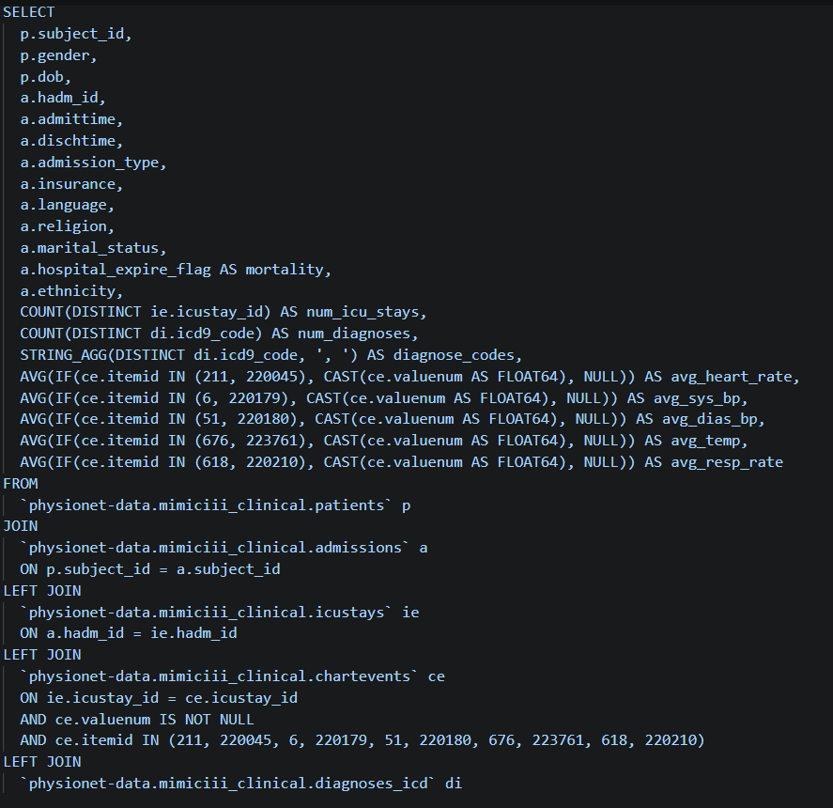
Data Sourcing Strategy
Target Dataset: physionet-data.mimiciii_clinical.
Cohort Filtering: The scope was narrowed to female patients with recorded ICU stays to build a highly targeted model.
Joined Entities: We merged data across patients, admissions, ICU stays, chart events (vitals), and diagnoses. (query attached)
Extraction Method: Heavy reliance on BigQuery to compute aggregations like num_icu_stays and average vitals in-database.

Slide 5
Phase 2: Data Preprocessing

Slide 6
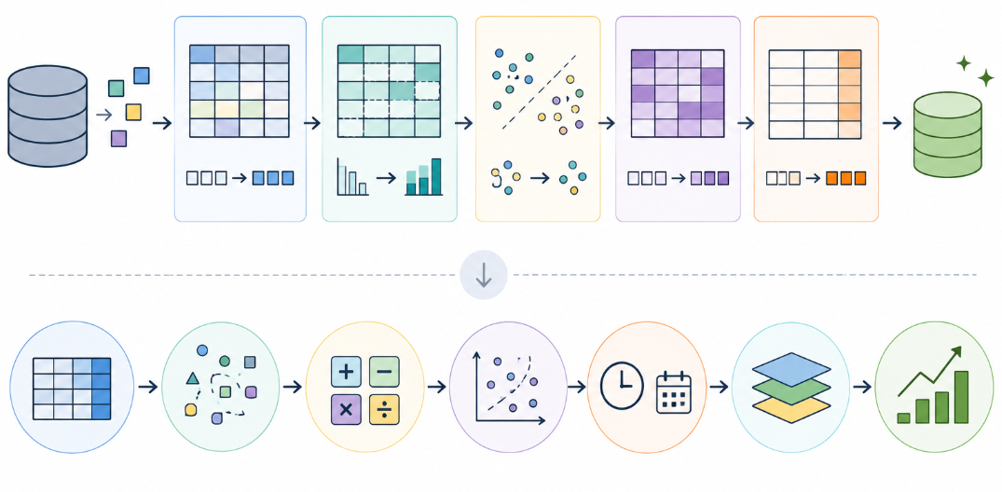
Preprocessing & Feature Engineering
Null Handling: Calculated null percentages for all variables. Dropped columns exceeding 20% missing values
Calculated Metrics: Engineered critical time-based metrics. Computed 'length_of_stay’, and 'age_at_admission’.
ICD-9 Grouping: Simplified complex ICD-9 diagnosis codes into 18 broader medical categories

Slide 7

Categorical Normalization
Religion Normalization: The dataset contained multiple fragmented religious affiliations. We utilized RegEx patterns to group these responses into a binary 'RELIGIOUS' vs. 'NOT RELIGIOUS' flag.
Ethnicity Compression: To prevent extreme high-cardinality in categorical features, we condensed the ethnicity data down to the top 5 most frequent groups (White, Asian, Black, Hispanic) and lumped the remainder into 'OTHER/UNKNOWN'.

Slide 8
Phase 3: Model Training

Slide 9
Data Splitting & Scaling Preparation
Step | Methodology | Outcome / Purpose
Data Splitting | Train/Test Split (80/20) | 8,000 samples for training, 2,000 samples for out-of-sample testing.
Null Imputation | Median Imputation | Replaced minor nulls in heart rate and respiratory rate with the median.
Categorical Encoding | One-Hot Encoding (Dummies) | Converted categories (insurance, admission_type, etc.) into binary vectors.
Feature Scaling | StandardScaler | Standardized numeric features to mean=0, variance=1 for stable model convergence.

Slide 10
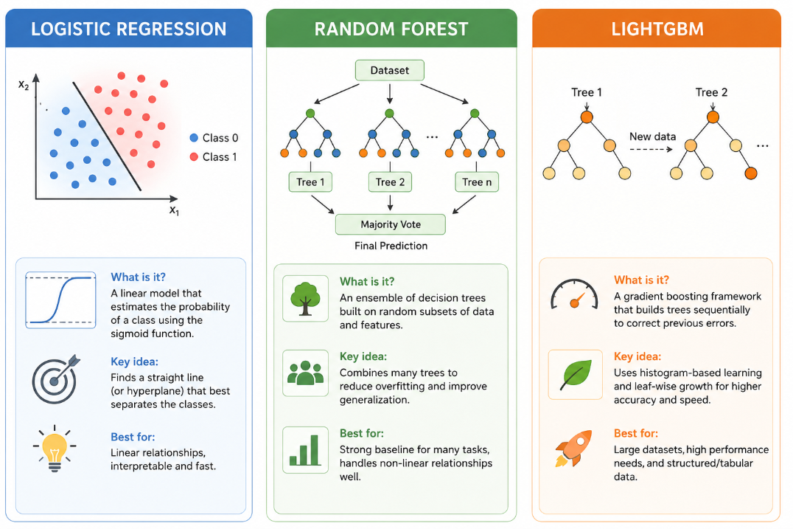
Algorithm Implementation

Slide 11
Hyperparameter Tuning Model
Automated Search
30
We utilized the Optuna library to navigate the complex hyperparameter search space automatically. By running 30 distinct trials using 5-fold cross-validation, the framework iteratively maximized our target metric: the F1-Score.
For LightGBM, this process aggressively optimized parameters like learning_rate, num_leaves, and feature_fraction.
Optuna Trials

Slide 12
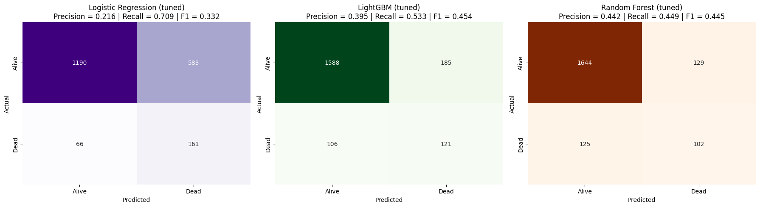
Confusion Matrix Comparison
By maximizing the f1 score, the with highest recall is logistic regression (0.709), random forest is the one with highest precision 0.44, while lightgbm is the best balance by having the best f1 score 0.454

Slide 13
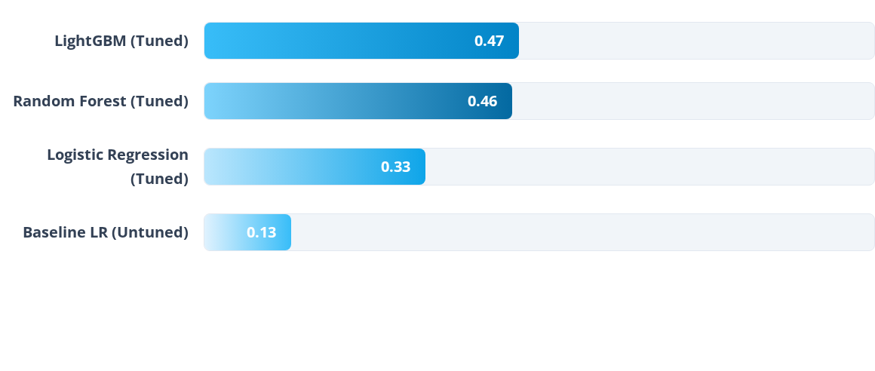
Optimized Model F1 Scores
Following Optuna hyperparameter optimization, the tree-based ensemble models (LightGBM and Random Forest) significantly outperformed linear approaches, successfully managing the imbalanced nature of patient mortality data.

Slide 14
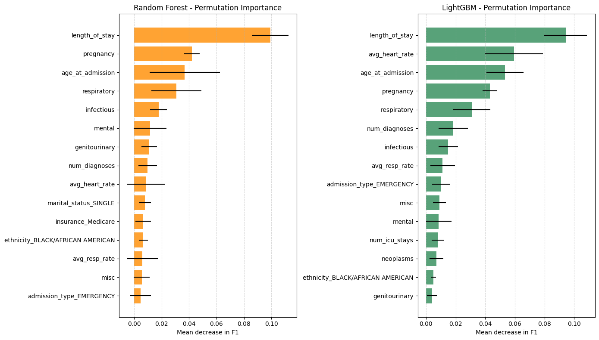
Key Predictors: Permutation Importance
Length of Stay: Proved to be the most critical feature driving predictive accuracy across all tuned models.
Average Heart Rate: Vital signs recorded via chart events represented a strong indicator of patient decline.
Age at Admission: Older age brackets naturally correlated with higher risks of mortality.
Specific Diagnoses: Recoded ICD-9 categories, particularly 'Respiratory' and 'Pregnancy' related issues, consistently ranked in the top 5 most important features.

Slide 15
Conclusion
The most important variable increasing the risk of mortality in women is length of stay, more days in ICU are related to a higher probability of death, followed by age and pregnancy condition.
By data extraction, preprocessing engineering clinical features, and utilizing hyperparameter tuning (Optuna), the predictive F1-score elevated from 0.13 to 0.45 on highly imbalanced critical care data.
The best model was LightGBM which let the F1-score metric, followed by random forest by small difference (0.44).

